Slide 1
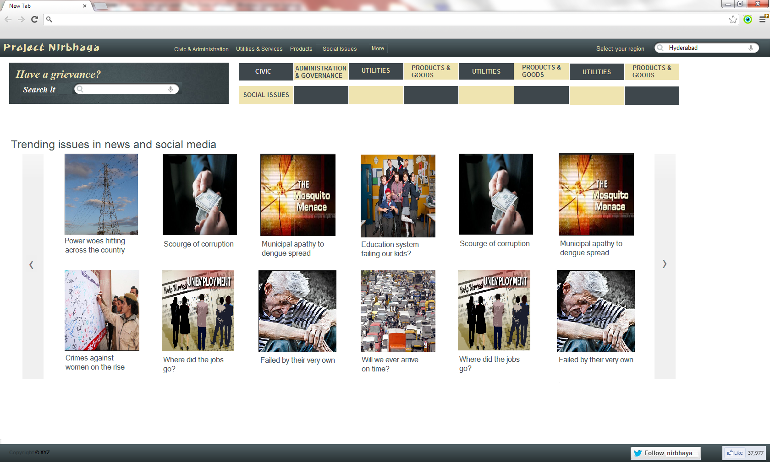
Notes:
UseCase 1.0 -User arrives at the first page.
-He/She sees the following:
-top level categories, displayed in the top bar.
-location filter pre-set to his current location, as determined by the location picker module.
-One of the top level categories is preselected, and accordingly the corresponding 2nd level categories are displayed.
-One of the second level categories are preselected, and accordingly the 3rd level categories (the big picture tiles in the middle of the page) are displayed.
-A search box displayed in the top-left portion, below the top bar.
-The above pre-selection behavior can be changed to a global (ALL) view (Need discussion)
OR
UseCase 1.2 -User arrives at the first page and enters a search criteria in the search box on the top left.
-The specific ‘Grievance Context’ is set by the system, and the User is taken to the 2nd page.

Slide 2
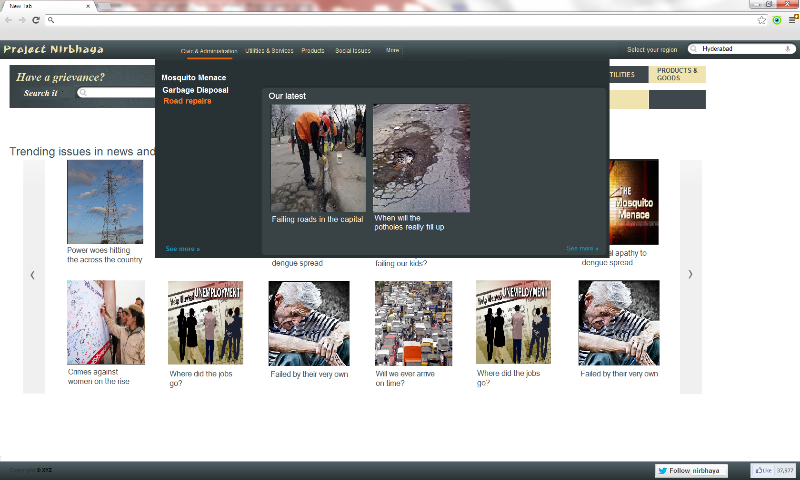
Notes:
UseCase 1.1 -User arrives at the first page and clicks a top level category (on the top bar)
-Accordingly the 2nd level categories change, with one of them pre-selected. He either keeps the preselected 2nd level category as it is, or prefers to select one from the 2nd level categories drop down. This also results in redraw of the 3rd level categories (picture tiles)
-He/She selects one of these 3rd level categories (picture tiles)
-The specific ‘Grievance Context’ is set by the system and the User is taken to the 2nd page.

Slide 3
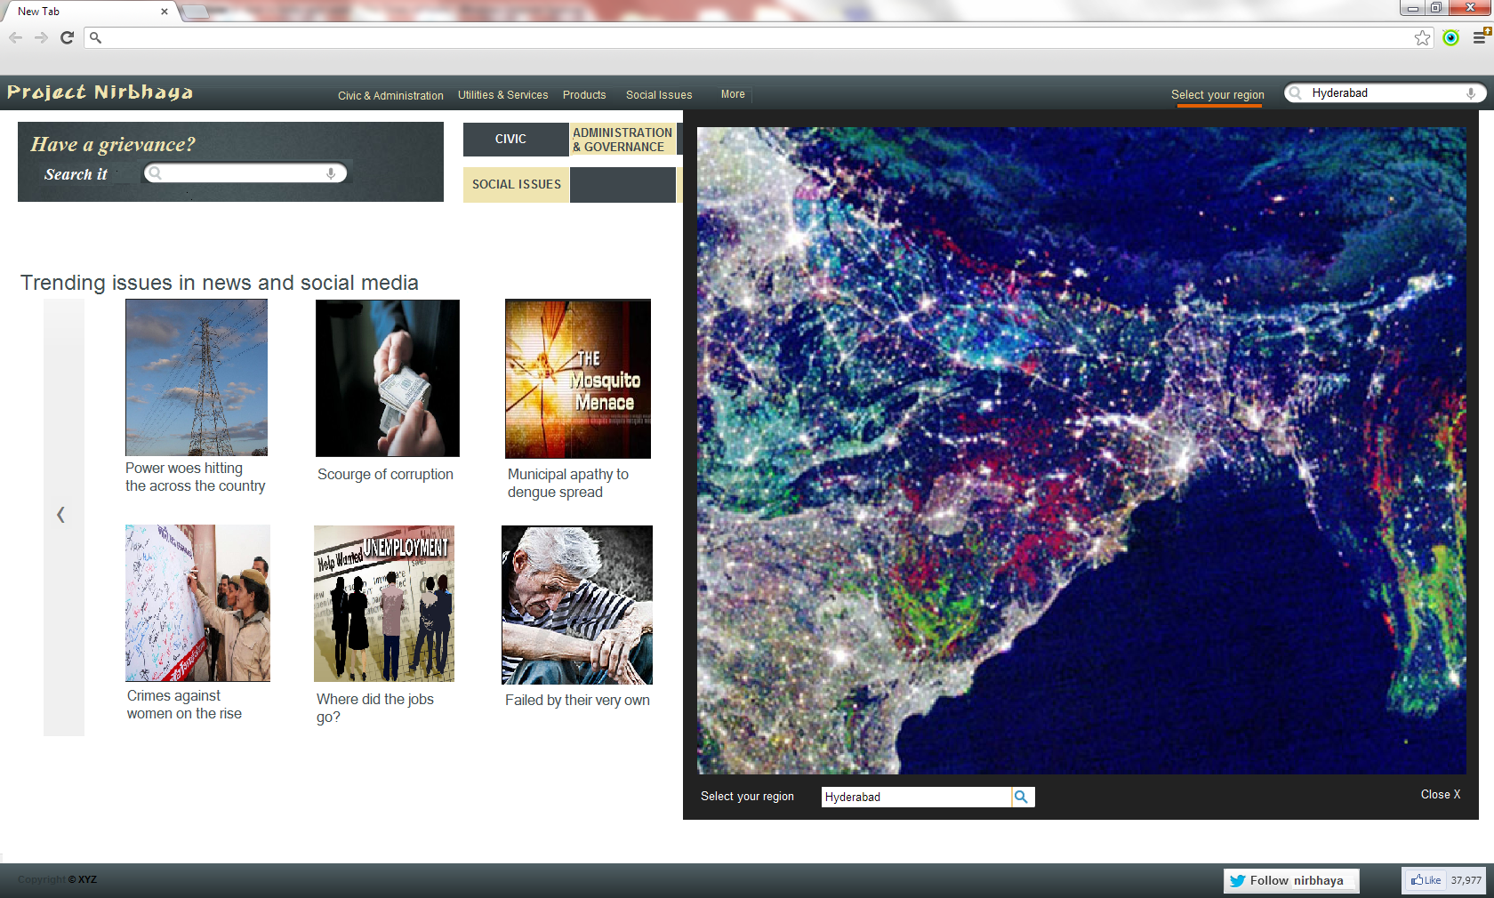
Notes:
UseCase 1.3 -User clicks on “Select your region” link on the top bar on the first screen.
-A drop down overlay showing the map of India is displayed.
-This map can be viewed as a Heat Map, showing the color coded regions, based on the intensity and type of grievances.
-The user can get an idea of the trending grievances with respect to various regions in India.
-He/She can then select a particular region on the map.
-He/She can also narrow down to a region on the map, using the “Select your region” search box, that is shown below the map.
Once a region is selected, the heat map overlay vanishes, displaying the screen 1 again.
-But now, all the grievance category menus are re-drawn with the categories corresponding to the selected region.

Slide 4
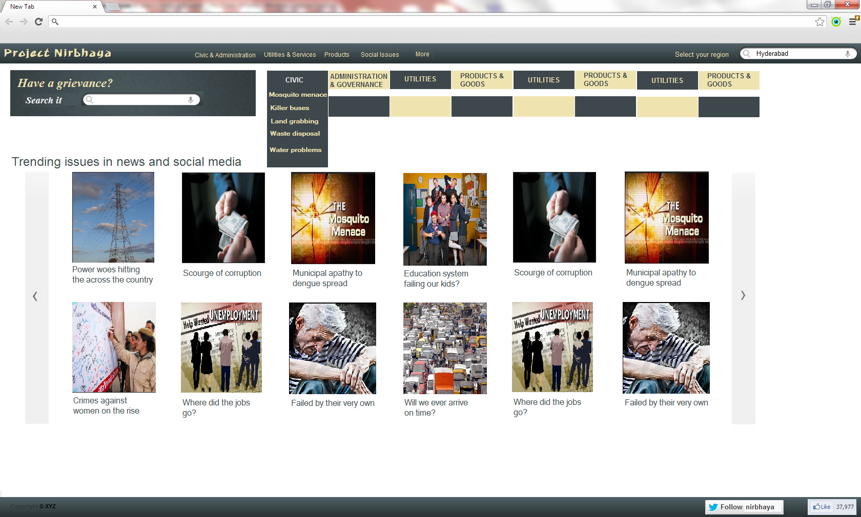
Notes:
UseCase 1.1 -User arrives at the first page and clicks a top level category (on the top bar)
-Accordingly the 2nd level categories change, with one of them pre-selected. He either keeps the preselected 2nd level category as it is, or prefers -to select one from the 2nd level categories drop down. This also results in redraw of the 3rd level categories (picture tiles)
-He/She selects one of these 3rd level categories (picture tiles)
-The specific ‘Grievance Context’ is set by the system and the User is taken to the 2nd page.

Slide 5
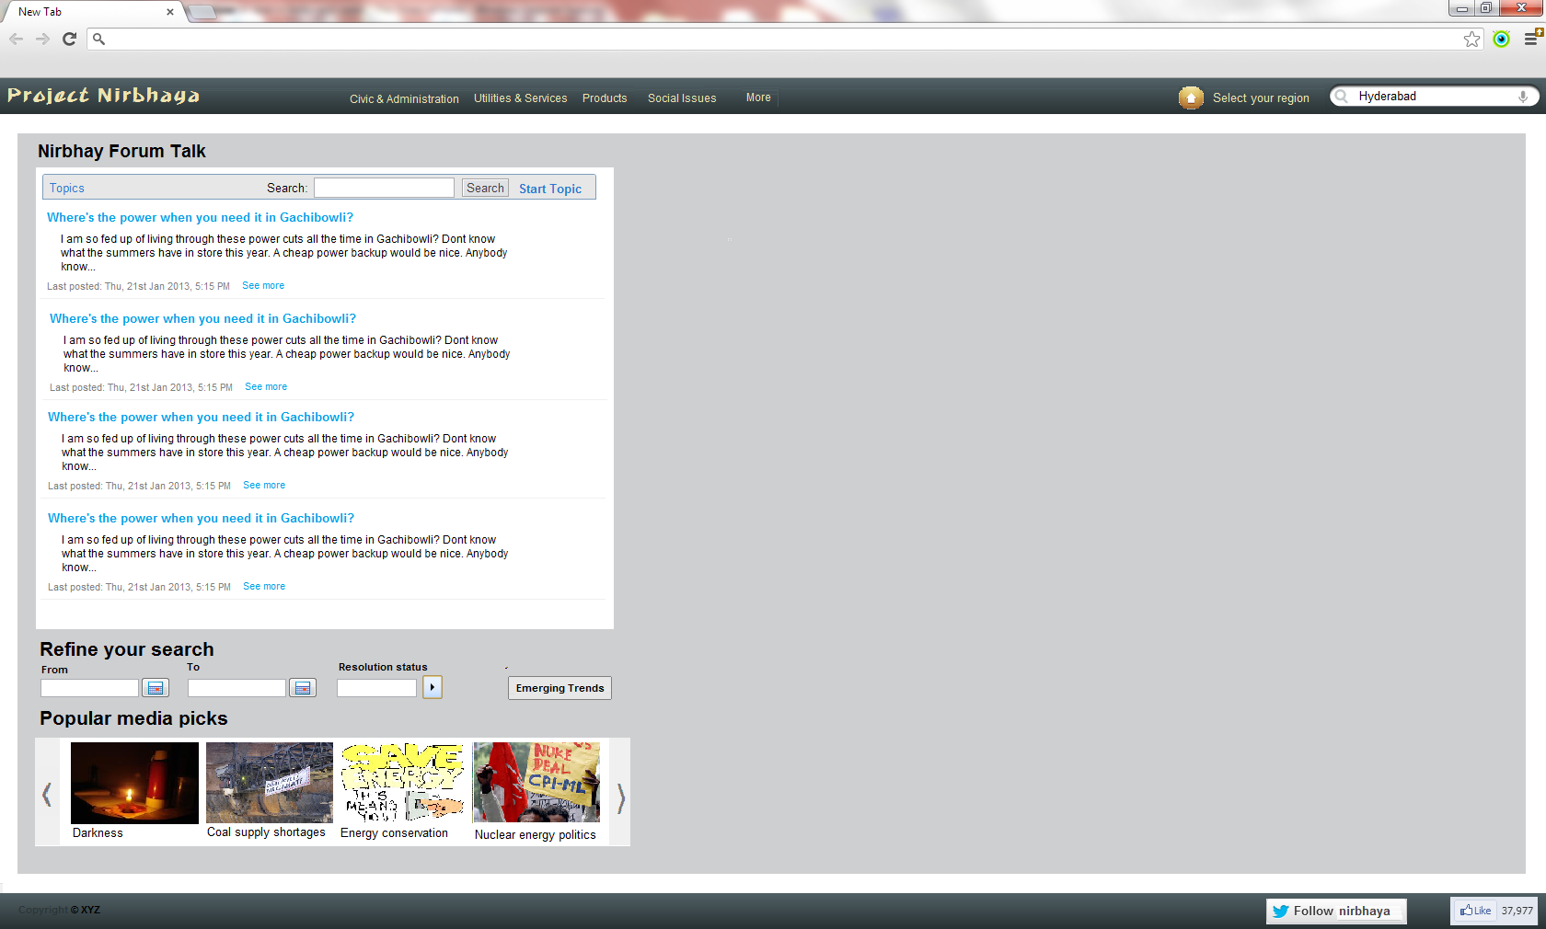
Notes:
Usecase 2.0 -User is taken to the 2nd page.
-He/She sees the following:
-A left top pane showing the system selected list of grievances, based on the ‘Grievance context’ set by either the search criteria (UC1.1) or the category selection criteria (UC1.2).
-These grievances are aggregated from across various sites and social media, and ranked according to their importance.
-A color indicator shall display the redressal/solved status of the grievance.
-On clicking “See more”, the right pane is redrawn with an overlay showing various details of the selected grievance.
-There are filter controls on top and bottom of this list of grievances (UC2.1).
-A button “Emerging trends” allows the user to analyse the grievance data in the system. (UC 2.3)
-A left bottom ribbon shows the popular media picks related to the ‘Grievance context’ set by either the search criteria (UC1.1) or the category selection criteria (UC1.2).
-On clicking one of these pictures in the ribbon, the right pane is redrawn with an overlay showing links from various media sources related to the selected grievance.

Slide 6
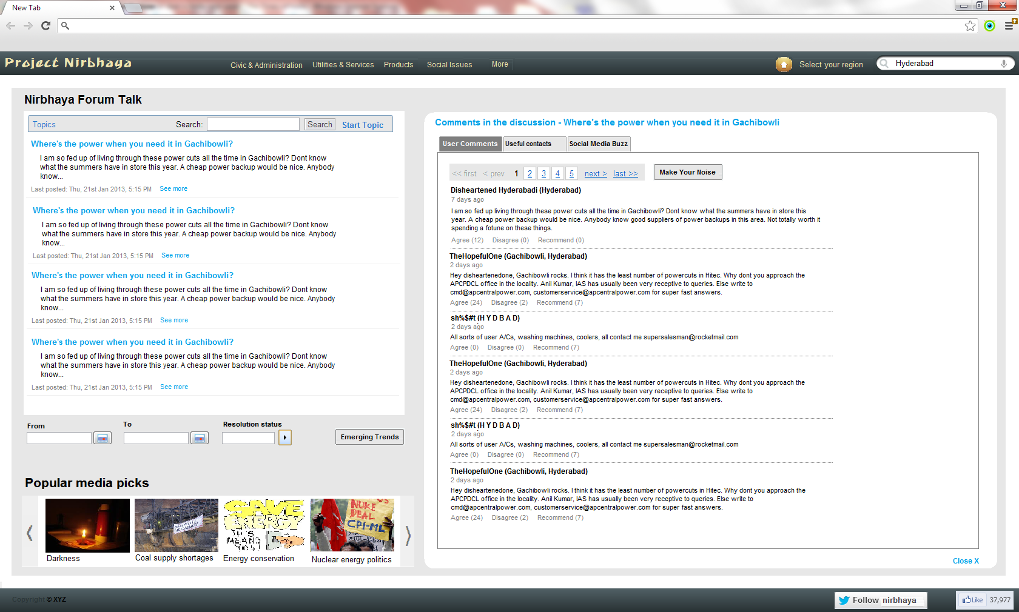

Slide 7
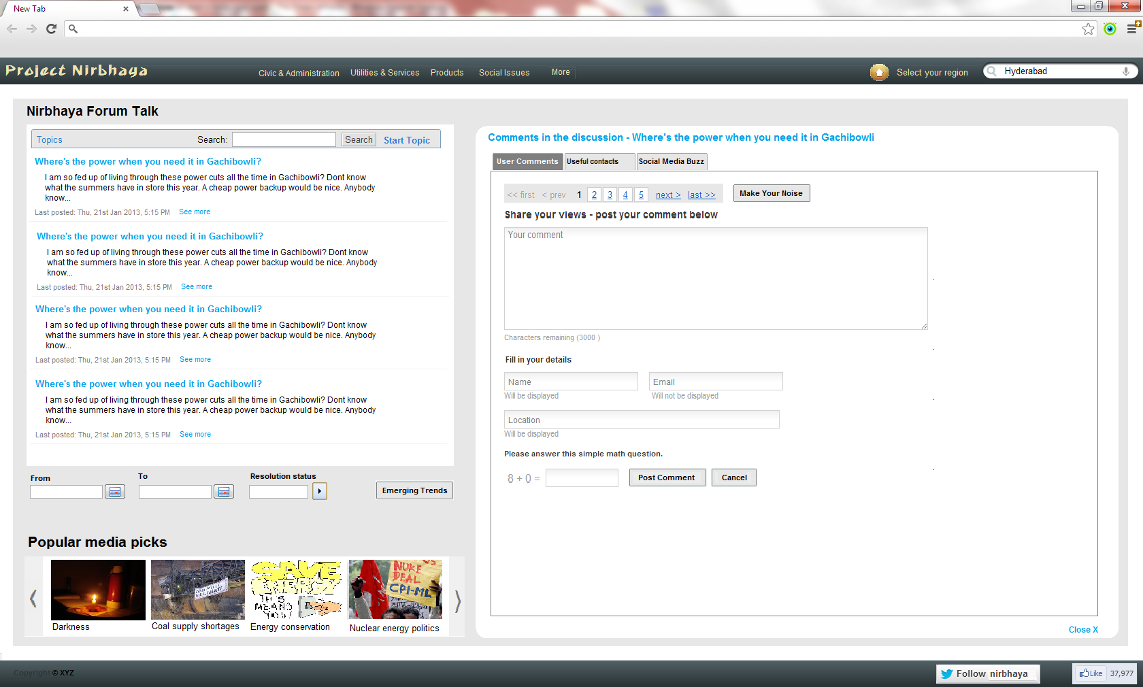
Notes:
UseCase 2.1 On the 2nd page’s left top pane (that shows the aggregated list of grievances), the user can perform the following action:
-He/She can click “Show more”, and go through the details of the the selected grievance, including the system-maintained user comments, grievance redressal contact details, and social media buzz. (UC2.2)
-If one of the displayed grievancs in the list is his/her ‘EXACT’ grievance, then he/she can select that as his/her grievance, by clicking the button “Is this your griavance?”
-This results in the appearance of a small overlay just below the selected grievance.
-The user can enter minimal details like name and contact, and click ‘OK’
-This results in increasing the weight of an existing grievance in the system. (This behavior is same as if an user enters a grievance that exactly matches to an existing grievance)
-User can scroll through the list of grievances displayed.
-He/She can filter the list of grievance through the AJAX filtering box that is present just above the list of grievances.
-The list of displayed grievances shall get filtered and show only based on the filter criteria.
-He/She can also filter the list of displayed grievances by date, where he can select a range; or by solution status of the grievances.
-In case the user does not find his/her exact grievance displayed, he/she can enter a new grievance into the system, using the “Enter your grievance” button.
-The right pane shall now show the “Enter your grievance” overlay, allowing the user to submit minimal details along with the grievance.
-On submitting the grievance, the overlay goes away, showing the ‘User Comments’ tab again.

Slide 8
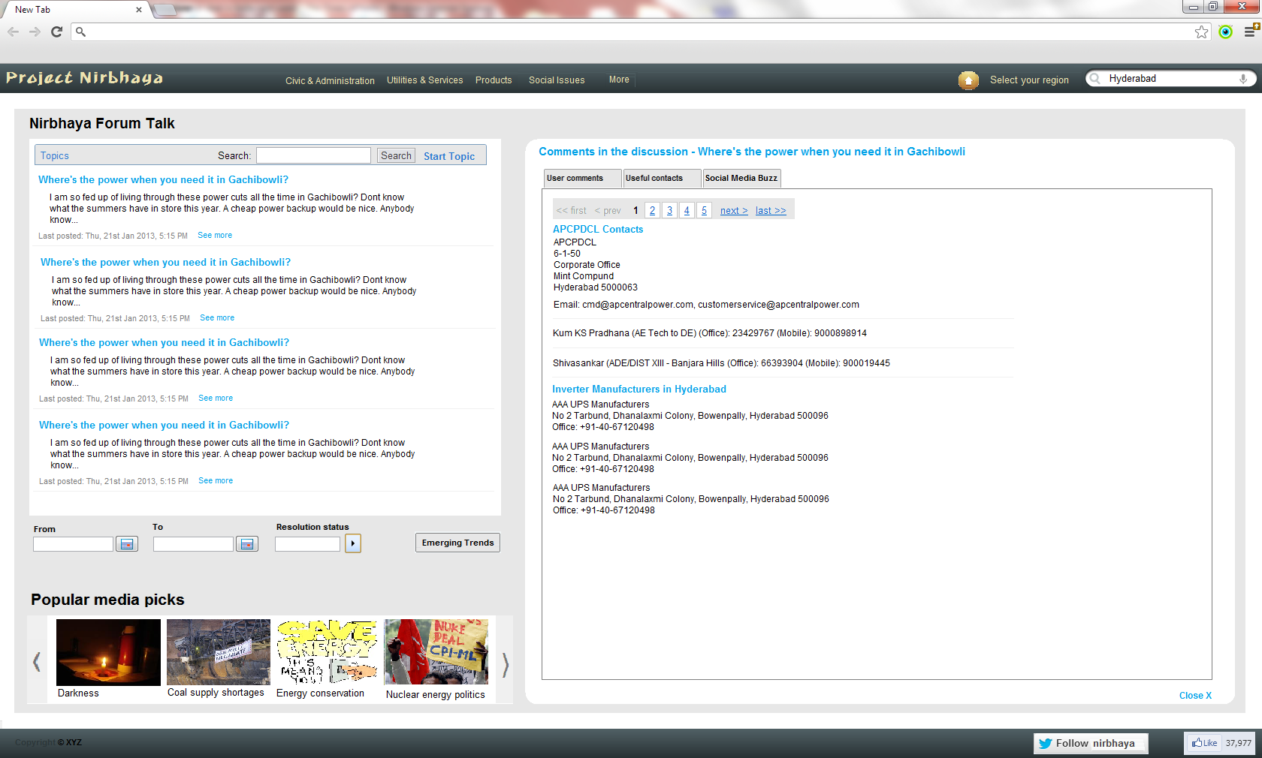
Notes:
UseCase 2.2 This usecase corresponds to the right pane of the 2nd page of the Nirbhaya UI.
This shows a tabular view, with 3 tabs:
-1st tab: User Comments
-This tab shows the system maintained user comments
-User can perform one of these 3 actions on each of these user comments: Agree, Disagree, or Mark as a solution (Recommend)
-These actions shall help in re-ranking of user comments, auto-selection of a prospective solution, and also in re-ranking of the list of grievances shown in the left top pane of this page.
-User can also post a comment by clicking the “Make your Noise” button on the ‘User Comments’ tab.
-A new overlay shall appear allowing him to enter his/her comments.
-On submitting the comment, the overlay goes away, showing the ‘User Comments’ tab again.
-2nd tab: Useful Contacts
-This tab shows the contacts selected by the system as ‘useful to redress the said grievance’.
-3rd tab: Social Media Buzz
-This tab will show the grievances posted on various social media sites, corresponding to the selected grievance.
-These social media grievances may represent the social sentiments related to a particular grievance. The system’s backend processor might have clustered these social media grievances, based on some criteria, and showing them as the system-maintained list of grievances on the left top pane.

Slide 9
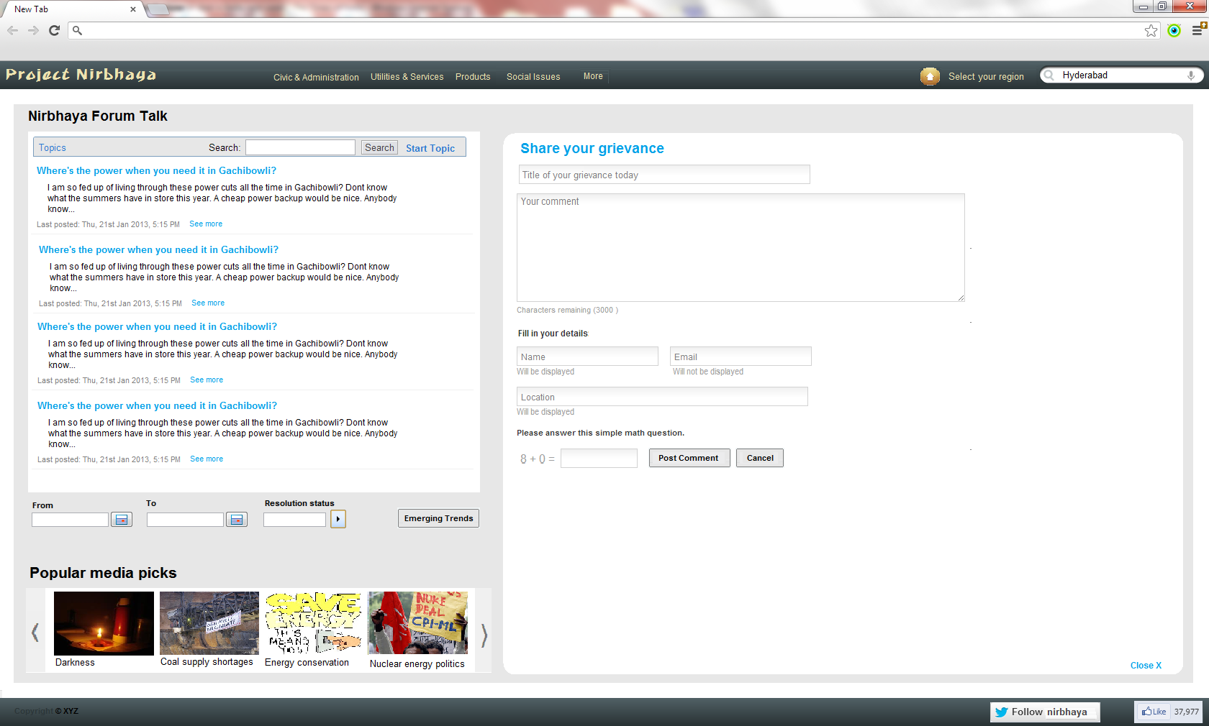

Slide 10
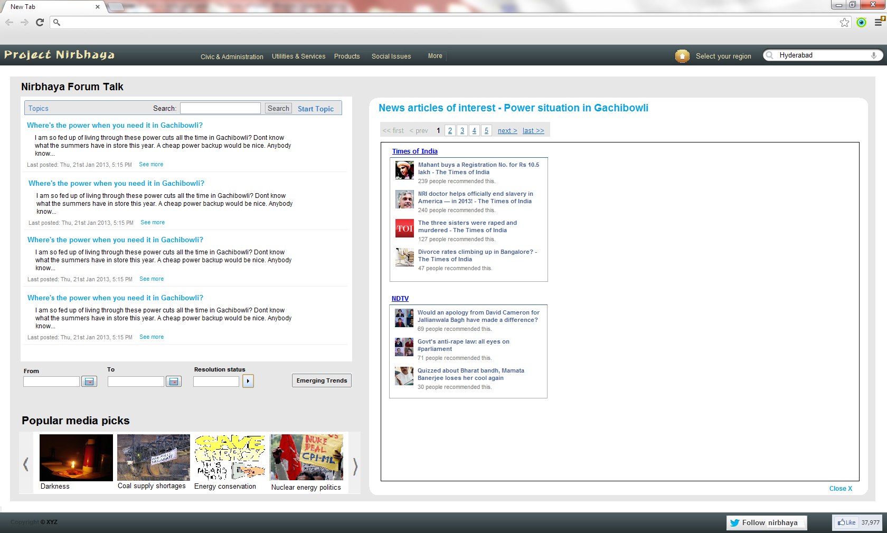

Slide 11
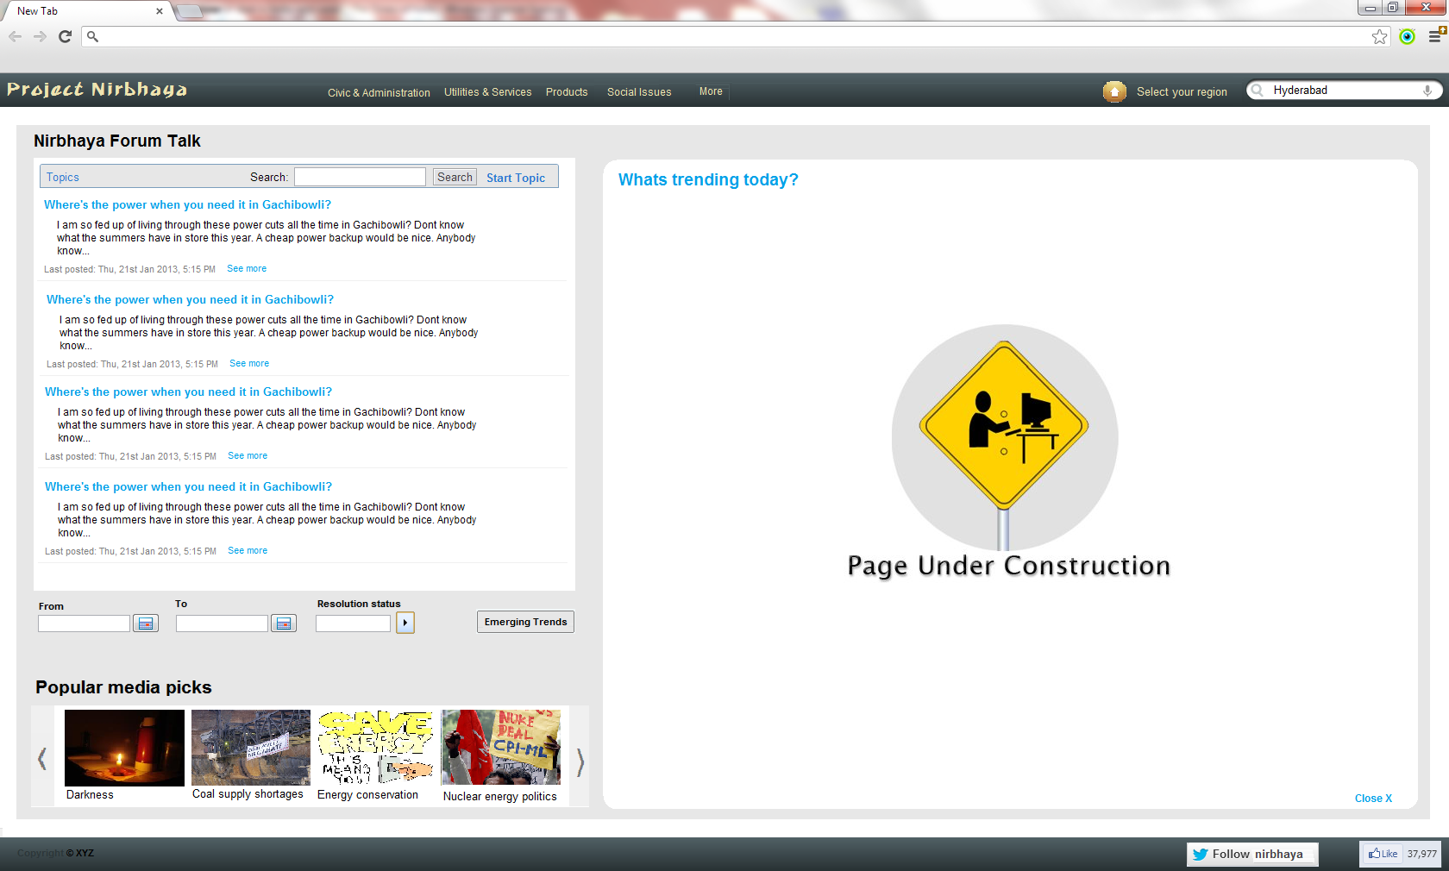
Notes:
UseCase 2.3 -User clicks Emerging Trends” on the left pane of the 2nd page of Nirbhaya UI.
-The right pane redraws and shows the possible analysers that can be selected for the given grievance.
-User clicks one of the analysers, for example a heat-map or a pie-chart, or a line-graph.
-An overlay comes up over the right pane, showing the analysis data in the selected analyser form.
-Notes:
-There shall be one fixed parameter associated with each analyser type. For example, if it is the heat-map then the fixed parameter would be geography (spatial); or if it is a line graph then the fixed parameter can be time.
-The analysers shall allow flexible parameters that are sent by the backend system, given a selected grievance category or grievance.
-Specific analysers shall allow the user to switch parameters or select from the list of flexible parameters.
-So in the analyser-selection screen, the UI shows only those analysers that have one identified fixed parameter, given the grievance context (selected grievance category or grievance).

